Slide 1

A Journey Through Azure Serverless Series Azure's Integration Platform: Building Serverless Applications 13 April, 11am CEST

Slide 2
Our Code of Conduct
Be welcoming and respectful
Be open to all questions and viewpoints
Be understanding of differences
Be kind and considerate to others
Be aware of others
Be friendly and patient
Microsoft is dedicated to empowering every person and every organization on the planet to achieve more. This includes Microsoft Reactor events where we seek to provide a respectful, friendly, professional experience for everyone, regardless of gender, sexual orientation, physical appearance, disability, age, race or religion. We do not tolerate any behaviour that is harassing or degrading to any individual, in any form. Individuals are responsible for knowing and abiding by these standards. We encourage everyone to assist in creating a welcoming and safe environment.

Slide 3

Speaker info
Eldert Grootenboer
Azure MVP and Technology Lead
Eldert can be described as an Azure MVP, Technology Lead, Cloud Solution Architect, blogger, public speaker and technical author. He can regularly be seen on conferences and user groups, speaking on Cloud related topics, with a strong focus on Azure. His experience with the Cloud comes from his daily work with these technologies in many innovative projects with various clients, as well as his drive to further dive into the latest developments in his spare time. Eldert enjoys sharing his knowledge with the community, and believes this is the best way to each other obtain more and better opportunities.

Slide 4
About the series
7/4
An Introduction to Azure Serverless
14/4
Azure's Integration Platform: Building Serverless Applications
21/4
Azure’s Data Platform: Building Serverless Applications
28/4
Building Stateful Serverless Applications Using Azure Durable Entities

Slide 5
Azure's Integration Platform: Building Serverless Applications

Slide 6



Eldert Grootenboer
@egrootenboer

Slide 7
Azure Integration Services

Slide 8

Integration scenarios
Application to Application
Business to Business
SaaS
IoT
Notes:
The architecture of applications

Slide 9
Integration challenges
Interfaces and APIs
Data sources and formats
Service-oriented and distributed
On-premises or cloud
Notes:
Despite the number of applications, there in an intrinsic dependencies to integration systems and applications, as they have multiple ways to address security, interfaces, data sources, they are distributed, run on premises or in the cloud, and each application has a unique lifecycle of updates, enhancements, fixes, etc.
It is costly to maintain integration code with multiple interfaces, APIs, data sources and formats, when applications are distributed across environments running on premises or in the cloud.

Slide 10
Integration Platform as a Service
Embrace the
API Economy
Establish a
Flexible Platform
Connect
SaaS, On-Prem, & Cloud
Notes:
Source: Gartner - Magic Quadrant for Enterprise Integration Platform as a Service, published April 2018

Slide 11




APIs
Workflows
Messages
Events

Slide 12
API Management
Logic Apps
Service Bus
Event Grid

Slide 13
Azure Integration Services

Slide 14




How they work together
API First
Orchestration of systems
Message store as infrastructure
Event driven model
Notes:
API First: customers build a library of reusable APIs, callable both within their organization, and where appropriate, between partners and applications.
Orchestration of systems: model processes into flexible, reusable flows. Surface them, where appropriate, as APIs. Use tooling that makes processes easy to understand and manage. Call out to code and custom components as needed.
Message store as infrastructure: storing messages becomes a key part of application design, bringing scale, reliability and agility.
Event driven model: build applications and integrations using events, creating a reusable, efficient model.

Slide 15



API Management
Connected experiences
Publish
Mediate
Consume
APIs
API Publishers
(provide APIs)
Azure portal
Gateway
Developer portal
App Developers
(use APIs)
Services and data
Notes:
Talk about the challenge, and how API Management solves each of these.
Azure Portal
Publish and maintain APIs
Set up policies, security, and access control
This is where we maintain our API catalog
Gateway
Proxy between frontend and backend
Decouples the backend from the connected experiences
Allows to implement governance and security controls without touching the backend
Developer Portal
Allows app developers to check which APIs are available
Can request access
Allows for easy getting started with testing, sample requests, and code samples
Rustig spreken!
3 minute

Slide 16
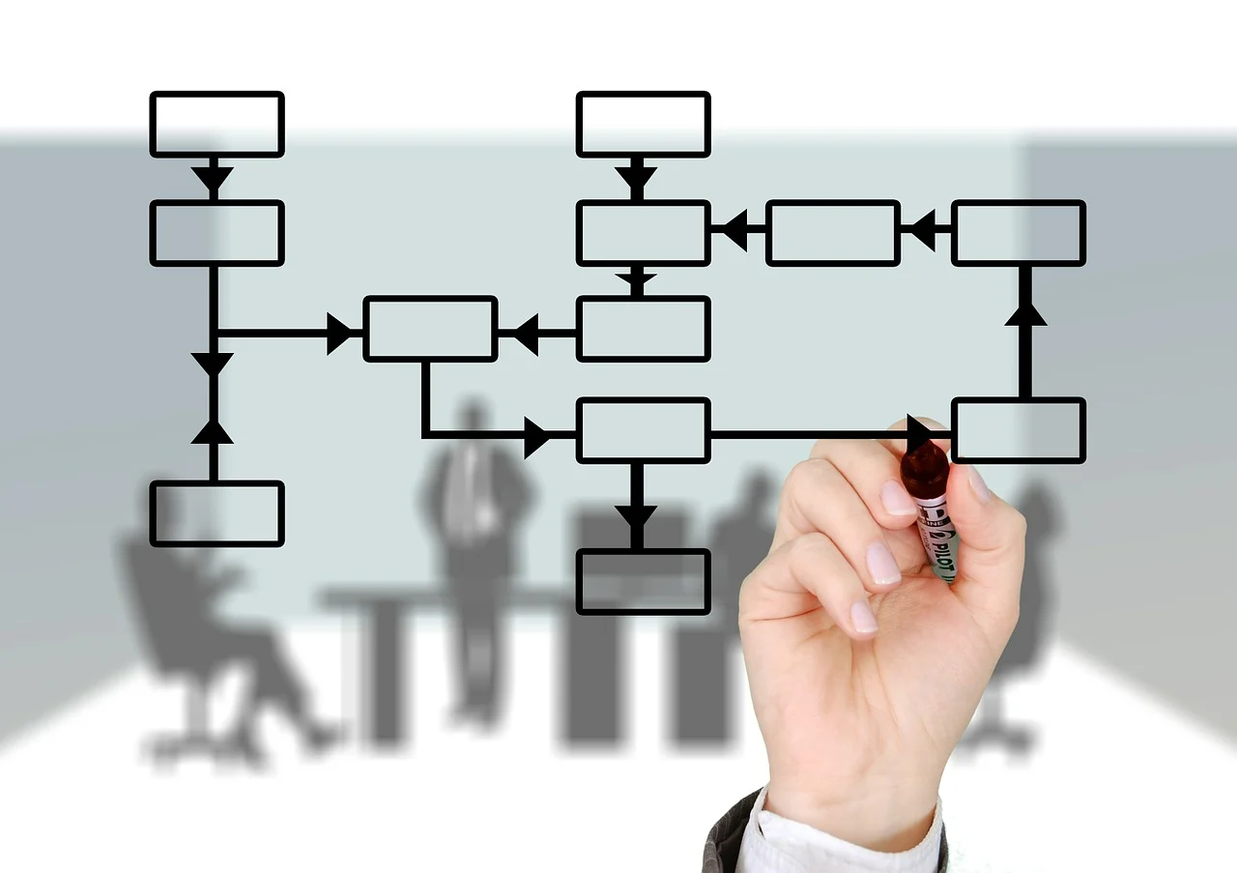
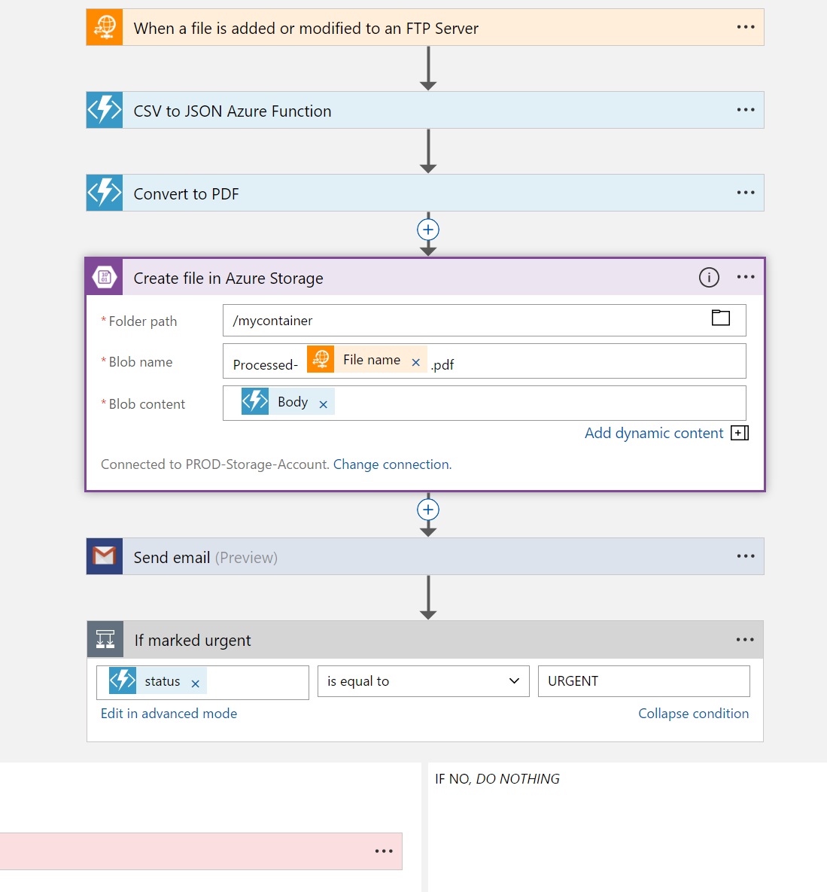
Logic Apps
Visual Designer
Workflow, triggers and actions
Applications, data and services
Notes:
Faster integration using innovative Visual Designer
Easy workflow creation with triggers and actions
Mashup applications, data and services
Built for mission critical Enterprise Integration
Create, deploy, manage and monitor

Slide 17
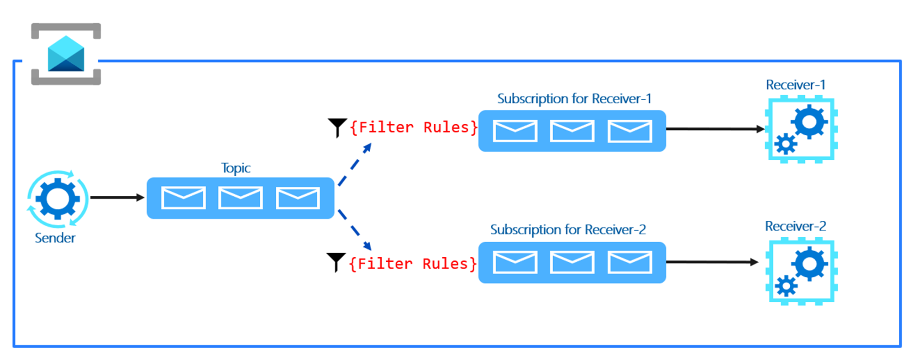
Service Bus
Queues & Topics
Reliable asynchronous communication
Message headers
Routing and filtering
Rich features

Slide 18
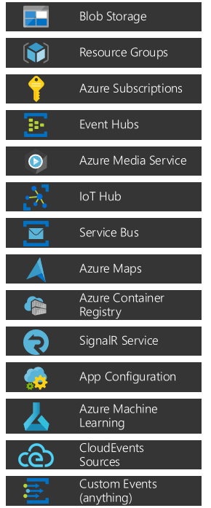
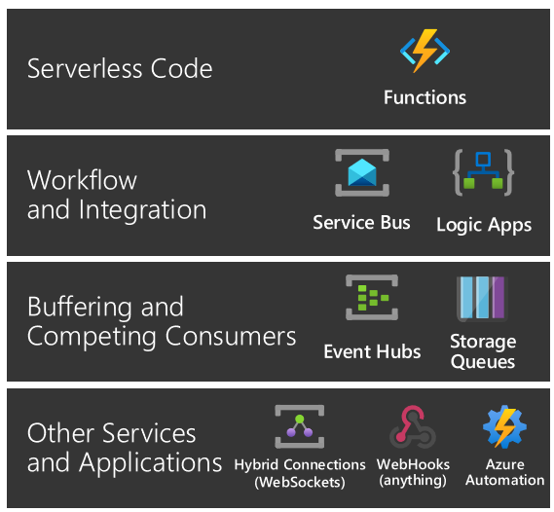

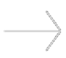
Event Grid
Events: what happened
Event Publishers: where it took place
Topics: where publishers send events
Event Subscriptions: how you receive events
Event Handlers: the app or service reacting to the event

Slide 19








Better Together
Limitless Possibilities

Slide 20












Demo – Onboarding Process

Slide 21
APIs

Slide 22
Solving our API strategy challenges
Connected experiences
Publish
APIs
Azure portal
Services and data
Notes:
Talk about the challenge, and how API Management solves each of these.
Azure Portal
Publish and maintain APIs
Set up policies, security, and access control
This is where we maintain our API catalog
Gateway
Proxy between frontend and backend
Decouples the backend from the connected experiences
Allows to implement governance and security controls without touching the backend
Developer Portal
Allows app developers to check which APIs are available
Can request access
Allows for easy getting started with testing, sample requests, and code samples
Rustig spreken!
3 minute

Slide 23
API Management
Connected experiences
Publish
Mediate
Consume
APIs
API Publishers
(provide APIs)
Azure portal
Gateway
Developer portal
App Developers
(use APIs)
Services and data
Notes:
Talk about the challenge, and how API Management solves each of these.
Azure Portal
Publish and maintain APIs
Set up policies, security, and access control
This is where we maintain our API catalog
Gateway
Proxy between frontend and backend
Decouples the backend from the connected experiences
Allows to implement governance and security controls without touching the backend
Developer Portal
Allows app developers to check which APIs are available
Can request access
Allows for easy getting started with testing, sample requests, and code samples
Rustig spreken!
3 minute

Slide 24
Smarter services with policies
Security
Caching
Throttling
Transformations
Mocking
And many more…
Notes:
8

Slide 25
Workflows

Slide 26
Logic Apps
Visual Designer
Workflow, triggers and actions
Applications, data and services
Enterprise Integration
Notes:
Faster integration using innovative Visual Designer
Easy workflow creation with triggers and actions
Mashup applications, data and services
Built for mission critical Enterprise Integration
Create, deploy, manage and monitor

Slide 27

Connected
Cloud APIs and platform functionality
Over 250 OOTB connectors
Hosted and managed
Scalable
Rapid development
Open source
API connections
Authenticate once and reuse
Simple to deploy
Easily manageable

Slide 28

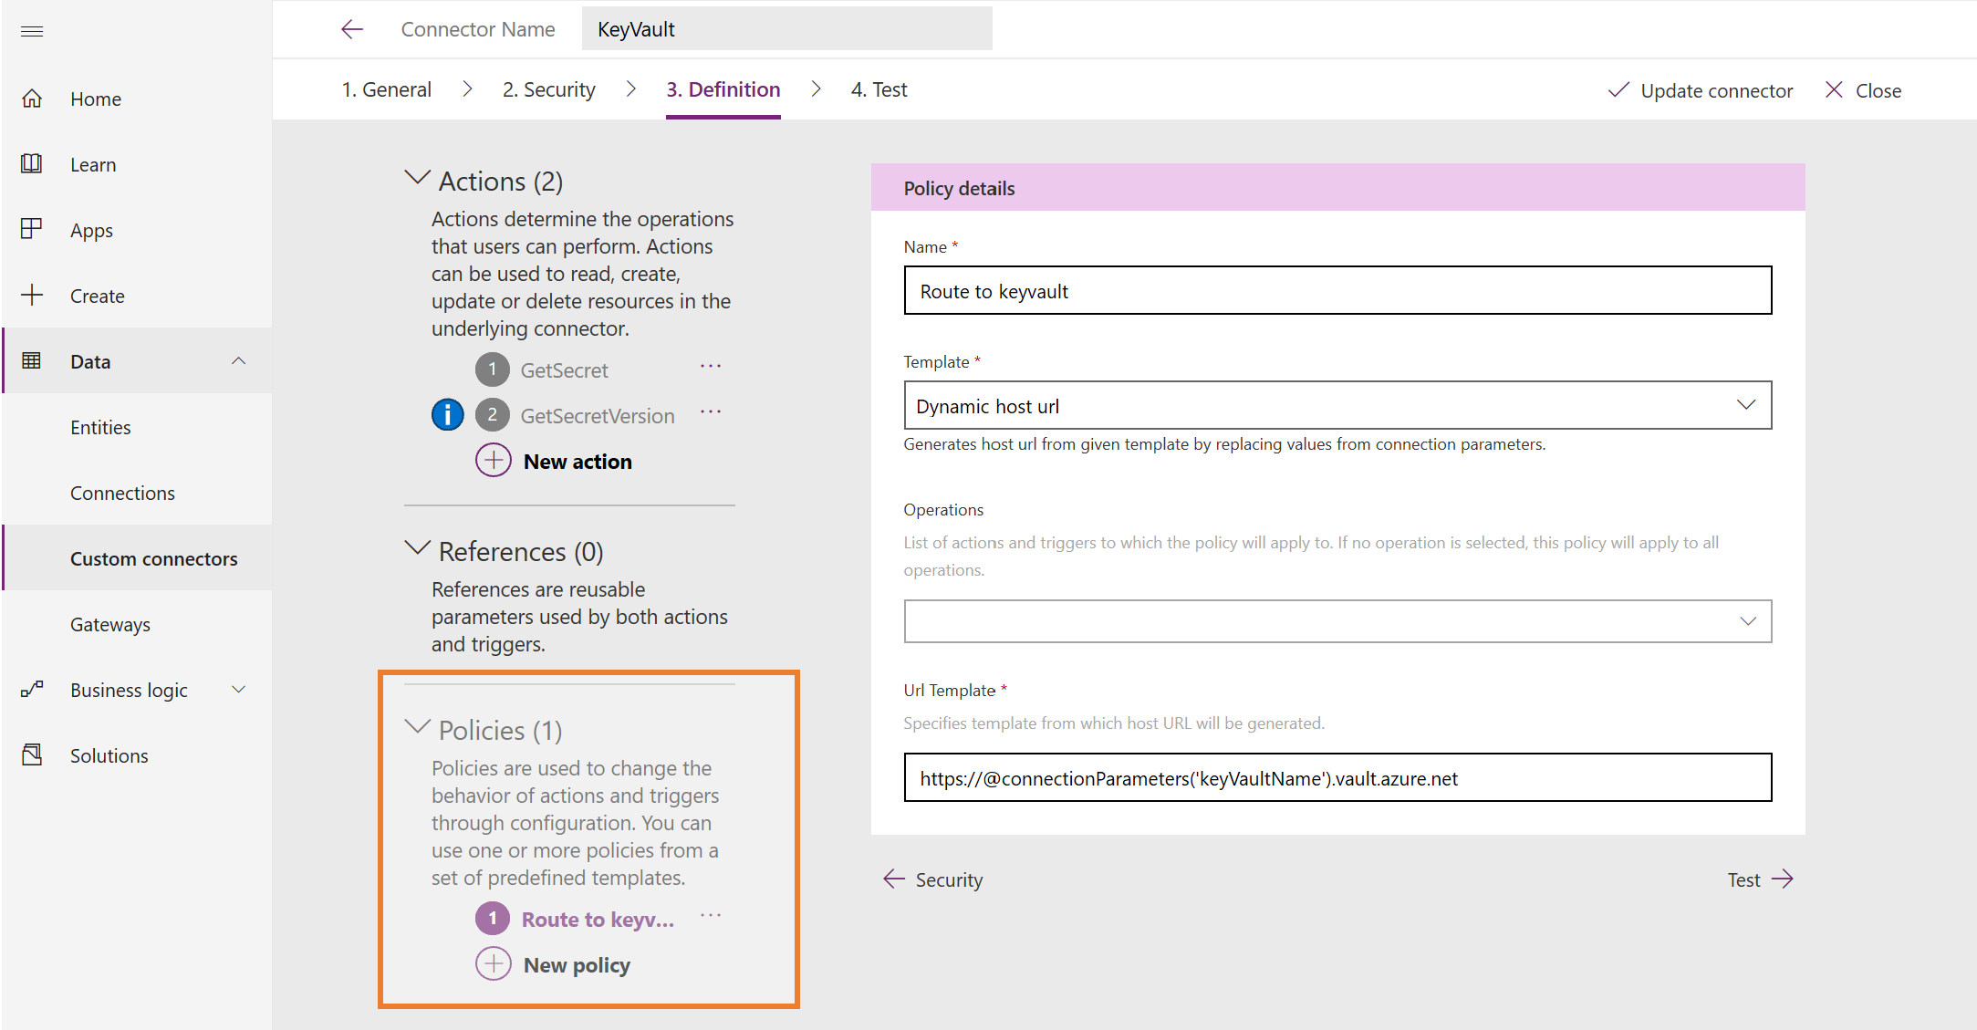
Custom Connectors

Slide 29
Messages

Slide 30
Enterprise Messaging as a Service
Queues & Topics
Reliable asynchronous communication
Message headers
Routing and filtering
Rich features

Slide 31
Features of Service Bus
Scheduled delivery
Time To Live
ForwardTo
Defer
Sessions
Batching
Auto-delete queue on idle
OnMessage
Duplicate detection
Actions
Transactions
Poison message handling

Slide 32
Topics & Subscriptions
Sender only knows about Topic
Receivers only know about Subscriptions
Filters and Actions exist on Subscriptions
type=order
Filter
Subscription 1
“type” = “order”
type=quote
Topic
“type” = “quote”
Subscription 2
Filter

Slide 33
Events

Slide 34
What is an event?
Something happened
Triggers a reaction
Based on facts
Can be series based or discrete

Slide 35
Azure Event Grid
Events: what happened
Event Publishers: where it took place
Topics: where publishers send events
Event Subscriptions: how you receive events
Event Handlers: the app or service reacting to the event

Slide 36

Advanced Filters
Works on the data portion of the event
Supports ten levels of nesting
Supports one or more values
Up to 10 advanced filters can be combined in OR
Numbers
NumberLessThan
NumberLessThanOrEquals
NumberGreaterThan
NumberGreaterThanOrEquals
NumberIn – the value for data.key equals a value in the set [0, 2.08, 3.14]
NumberNotIn – the value for data.key is not in the set [1, 11, 112, 1124]
Strings
StringContains – the value for data.key contains “the”
StringIn – the value for data.key equals a value in the set [“small”, “brown”, “fox”]
StringNotIn – the value for data.key equals a value in the set [“jumped”, “over”, “the”]
StringBeginsWith – the value for data.key begins with “lazy”
StringEndsWith – the value for data.key ends with “dog”
Boolean
BoolEquals

Slide 37
Bringing it all Together

Slide 38
Better Together
Limitless Possibilities

Slide 39
Demo – Onboarding Process

Slide 40
Almost done…

Slide 41

Key Takeaways
Serverless
Focus on value
Cost Efficient
Only pay for what you use
Better Together
Combine services to create powerful scenarios

Slide 42
For more learning on this topic, visit Learn TV on https://aka.ms/CreateServerlessApps-12 https://aka.ms/AzureSynapseAnalytics-12 https://aka.ms/BuildDataAnalytics-12 https://aka.ms/ArchitectMessageBroker-12
Survey Link: https://aka.ms/Reactor/Survey
Please enter the event code 13120 at the start of survey

Slide 43

Join our community
meetup.com/Microsoft-Reactor-Stockholm/
@MSFTReactor
Microsoft Reactor at Epicenter,
Master Samuelsgatan 36, 5th floor,
111 57 Stockholm Sweden
Questions? ReactorStockholm@microsoft.com
http://www.youtube.com/c/MicrosoftReactor
ReactorStockholm@microsoft.com

Slide 44




Thank You!
@egrootenboer
eldert@eldert.net
https://www.linkedin.com/in/eldert-grootenboer
Notes:
Rustig spreken!

